Slide 1

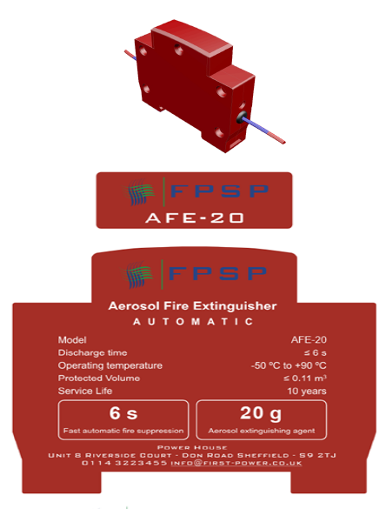
FPSP PRESENTATION JUNE 2026 ON
HEAT AEROSOL FIRE SUPPRESSION DEVICE
Principles, components, applications, and maintenance considerations

Slide 2

AGENDA
Purpose, scope
Aerosol fire suppression device
Suppression mechanism
Core components, construction
Activation, discharge sequence
Agent chemistry, fire inhibition
System design, integration
Applications, hazard classes

Slide 3
PURPOSE AND SCOPE
DEVICE PURPOSE
PRESENTATION SCOPE
Intended function
An aerosol fire suppression device is intended to detect or respond to a fire event and rapidly release a condensed aerosol extinguishing agent to interrupt combustion before the fire grows into a larger incident.
These devices are commonly selected where fast automatic response, compact equipment footprint, and reduced cleanup versus some traditional suppression methods are important. The technology is typically considered for enclosed or semi-enclosed spaces containing valuable electrical, mechanical, or process equipment.
What this deck covers
This deck covers the device definition, operating principle, construction, discharge sequence, agent chemistry, design considerations, common use cases, limitations, and maintenance expectations.
The goal is to provide a practical technical overview for engineers, facility managers, safety professionals, and decision-makers evaluating fire protection options. Aerosol systems should always be selected, designed, installed, and maintained in accordance with applicable codes, standards, manufacturer instructions, and site-specific hazard assessments.

Slide 4
WHAT AN AEROSOL FIRE SUPPRESSION DEVICE IS
How it works in enclosed hazards

Slide 5
HOW SUPPRESSION WORKS
Fire initiation and detection
01
02
Ignition of the aerosol-forming compound
A developing fire introduces heat, flame, or combustion products into the enclosure. Automatic detection, thermal actuation, or integrated release can trigger discharge; early activation is most effective before spread or enclosure breach.
An electrical or thermal initiator starts a controlled internal reaction. It is engineered to generate extinguishing aerosol predictably, while internal design manages pressure, temperature, and flow for reliable agent production.
03
AEROSOL
COOLING
Agent distribution throughout the enclosure
Chemical inhibition of combustion
The aerosol forms microscopic particles suspended in gas, then fills the enclosure and moves around obstacles. Suspension time helps it reach hidden flame zones, though enclosure integrity, volume, and ventilation determine final concentration.
The aerosol suppresses fire mainly by interrupting free-radical flame reactions, rapidly lowering flame intensity. Reignition remains possible if heat persists, oxygen re-enters quickly, or the hazard exceeds design concentration and hold time.
04
05

Slide 6
Core Components and Construction
COMPONENT | FUNCTION | TYPICAL DESIGN CONSIDERATION
Outer Housing | Contains the active materials and directs the discharge safely into the protected space. | Must withstand internal reaction conditions, resist corrosion, and fit the installation environment.
Aerosol-Forming Compound | Generates the extinguishing aerosol when initiated. | Formulation must provide predictable output, stable shelf life, and consistent suppression performance.
Initiator / Ignition Assembly | Starts the controlled reaction electrically or thermally. | Requires reliable activation, compatibility with control circuits, and protection against accidental operation.
Cooling / Filtering Section | Reduces discharge temperature and captures larger by-products before release. | Important for equipment compatibility, cleaner discharge, and safer agent flow characteristics.
Nozzle or Discharge Port | Releases and disperses the aerosol into the enclosure. | Placement and orientation affect coverage, flow path, and distribution efficiency.
Mounting and Electrical Interfaces | Secure the device and connect it to detection or control systems. | Must support vibration resistance, service accessibility, and integration with alarm or shutdown functions.

Slide 7
ACTIVATION AND DISCHARGE SEQUENCE
Standby Condition
Installed and passive, relying on enclosure integrity, clear discharge paths, and system supervision.
Detection / Release Signal
Heat, smoke, flame, or manual release triggers action; detection speed is critical.
Initiation
The initiator activates the internal process that consistently generates the aerosol agent.
Discharge and Flooding
Aerosol rapidly fills the enclosure; concentration, retention, and flame interaction drive suppression.
Post-Discharge State
Assess for residual heat, reignition, contamination, ventilation needs, and replace the discharged unit.
Effective performance depends on rapid detection, proper enclosure conditions, and safe post-discharge assessment before restoration.

Slide 8
Agent Chemistry and Fire Inhibition
WHAT THE AGENT CONTAINS
HOW THE FLAME IS INTERRUPTED
WHY CHEMISTRY MUST MATCH THE HAZARD
Condensed aerosol agents start from a solid composition that, when activated, forms fine particles in gas. Unlike mist, foam, or inert gas, suppression comes mainly from flame-zone chemistry rather than cooling alone.
Combustion relies on free-radical chain reactions. Aerosol particles interact with those radicals and slow flame propagation, making suppression effective in enclosed volumes where concentration builds quickly and lasts long enough to break the cycle.
Not all fires respond equally. Deep-seated, fuel-fed, or highly ventilated scenarios may need added measures. Suitability depends on fuel type, enclosure geometry, ventilation rate, and reignition potential.

Slide 9
SYSTEM DESIGN AND INTEGRATION CONSIDERATIONS
Protected Volume Definition
Hazard Characterization
Device Placement
Detection and Controls Integration
Enclosure size, shape, obstructions, leakage paths, and ventilation determine whether aerosol concentration can be achieved. A device that works in a sealed cabinet may underperform in a larger or frequently opened space with high air exchange.
Define fuel type, ignition sources, equipment energized state, and expected fire growth. System selection should match the actual hazard, not a generic assumption that all electrical or machinery spaces behave the same under fire conditions.
Mounting location affects distribution, cooling, and coverage. The discharge path should avoid dead zones while accounting for nearby components, cable routing, and maintenance access.
Aerosol devices often perform best when tied to alarm, shutdown, and interlock functions. Isolating power, stopping fans, or shutting off fuel can improve suppression effectiveness and reduce reignition risk.
Human Safety and Occupancy Considerations: Consider whether the space is occupied, how personnel will be warned, and what post-discharge procedures apply. Visibility reduction, by-products, and re-entry protocols matter in real operations.
Code Compliance and Documentation: Design must meet standards, approvals, manufacturer instructions, project docs; include calculations, drawings, commissioning, maintenance.

Slide 10
APPLICATIONS AND SUITABLE HAZARD CLASSES
ELECTRICAL CABINETS & PANELS
MACHINERY & ENGINE COMPARTMENTS
TELECOM, DATA & INDUSTRIAL ENCLOSURES
HAZARD CLASS SUITABILITY
Used for switchgear, PLC, battery, and control enclosures where compact, dense spaces make bulky suppression difficult and fast local action can reduce damage.
Suitable for enclosed mechanical spaces where heat, wiring, lubricants, and tight geometry increase fire risk and automatic activation helps when response is delayed.
Remote cabinets, shelters, and industrial housings may benefit where water is undesirable, space is limited, and monitoring integration supports unattended operation.
Commonly linked to some enclosed Class A, Class B, and electrical hazards, but suitability depends on fuel, enclosure, approvals, and regulations.

Slide 11
PERFORMANCE FACTORS AND LIMITATIONS
KEY PERFORMANCE FACTORS
IMPORTANT LIMITATIONS
System effectiveness depends on early detection, correct agent quantity, adequate concentration, enclosure integrity, proper device placement, and compatibility between the suppression mechanism and the fuel involved. Even a well-designed aerosol generator can underperform if ventilation removes the agent too quickly or if internal obstacles prevent uniform distribution. Ambient conditions, vibration, contamination, and lifecycle aging can also reduce long-term reliability if they are not addressed through design choices and a disciplined maintenance strategy.
Aerosol suppression is not a universal solution for every fire scenario. It may be less suitable for open environments, highly ventilated spaces, deep-seated combustibles, continuously flowing fuel fires, or hazards where post-discharge residues are unacceptable. Discharge can leave fine particulates that require cleanup and equipment assessment, and suppression does not remove the need to isolate ignition sources or verify extinguishment. These devices should be evaluated as one option within a broader fire protection strategy, not as a substitute for hazard reduction, sound enclosure design, and emergency response planning.

Slide 12
INSPECTION, TESTING, AND MAINTENANCE
VISUAL INSPECTION
ELECTRICAL AND CONTROL VERIFICATION
ENVIRONMENTAL CONDITION REVIEW
TESTING, DOCUMENTATION, AND REPLACEMENT
Confirm secure mounting, no damage or obstruction, and no corrosion, contamination, or modification. Labels, identification, and service dates must remain legible and match records.
Verify supervision, release circuits, detection interfaces, alarm links, and shutdown logic. Control wiring faults can prevent actuation even when the generator itself remains serviceable.
Check that temperature, moisture, dust, vibration, and chemical exposure remain within approved installation limits, as site conditions directly affect service life and reliability.
Follow manufacturer and code guidance for panel, detector, continuity, and commissioning tests. Keep accurate records, and plan replacement after discharge or listed end of life.

Slide 13
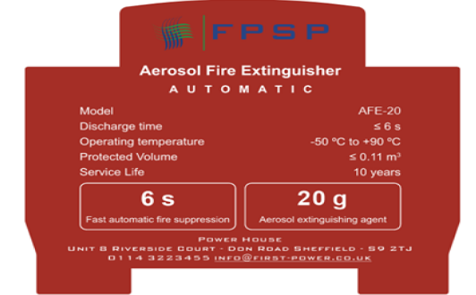
KEY TAKEAWAYS
DESIGN AND INTEGRATION
MAINTENANCE
Compact, fast-acting fire suppression for enclosed hazards depends on correct system design and effective integration.
Ongoing maintenance is not required to preserve readiness, reliability, and suppression performance over time.

